Slide 1
Information Processing and Retrieval Project
Gonçalo Teixeira, up201806562
Pedro Pinto, up201806251
Pedro Azevedo, up201806728

Slide 3
Enhancing UX
We decided to upgrade user experience by developing a web application and adding some extra information features to the already built system:
Using React + ExpressJS + Solr
Adding (another) external data source (TMDb) to fetch multimedia data and extra information (posters, profile pictures, ...)
This application allows for easy search tasks with filters and custom sorting methods to enhance user experience and make a real-world case scenario for this search system.

Slide 4
Web Application
Built with React + ExpressJS + Solr

Slide 5
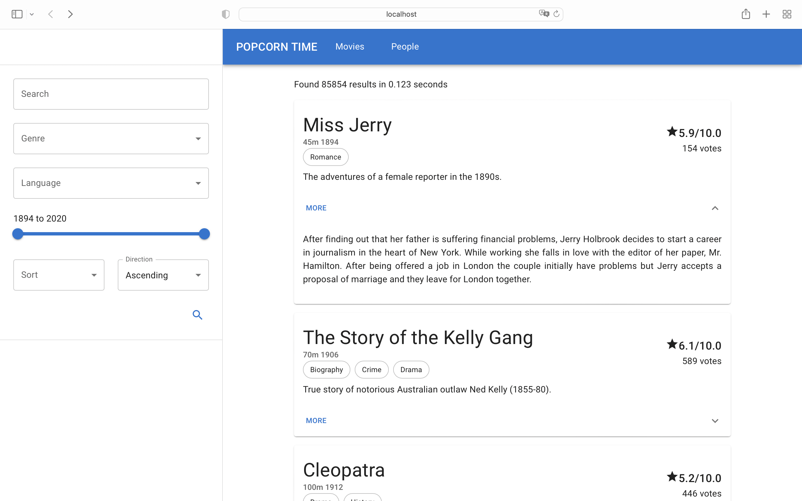

Slide 6
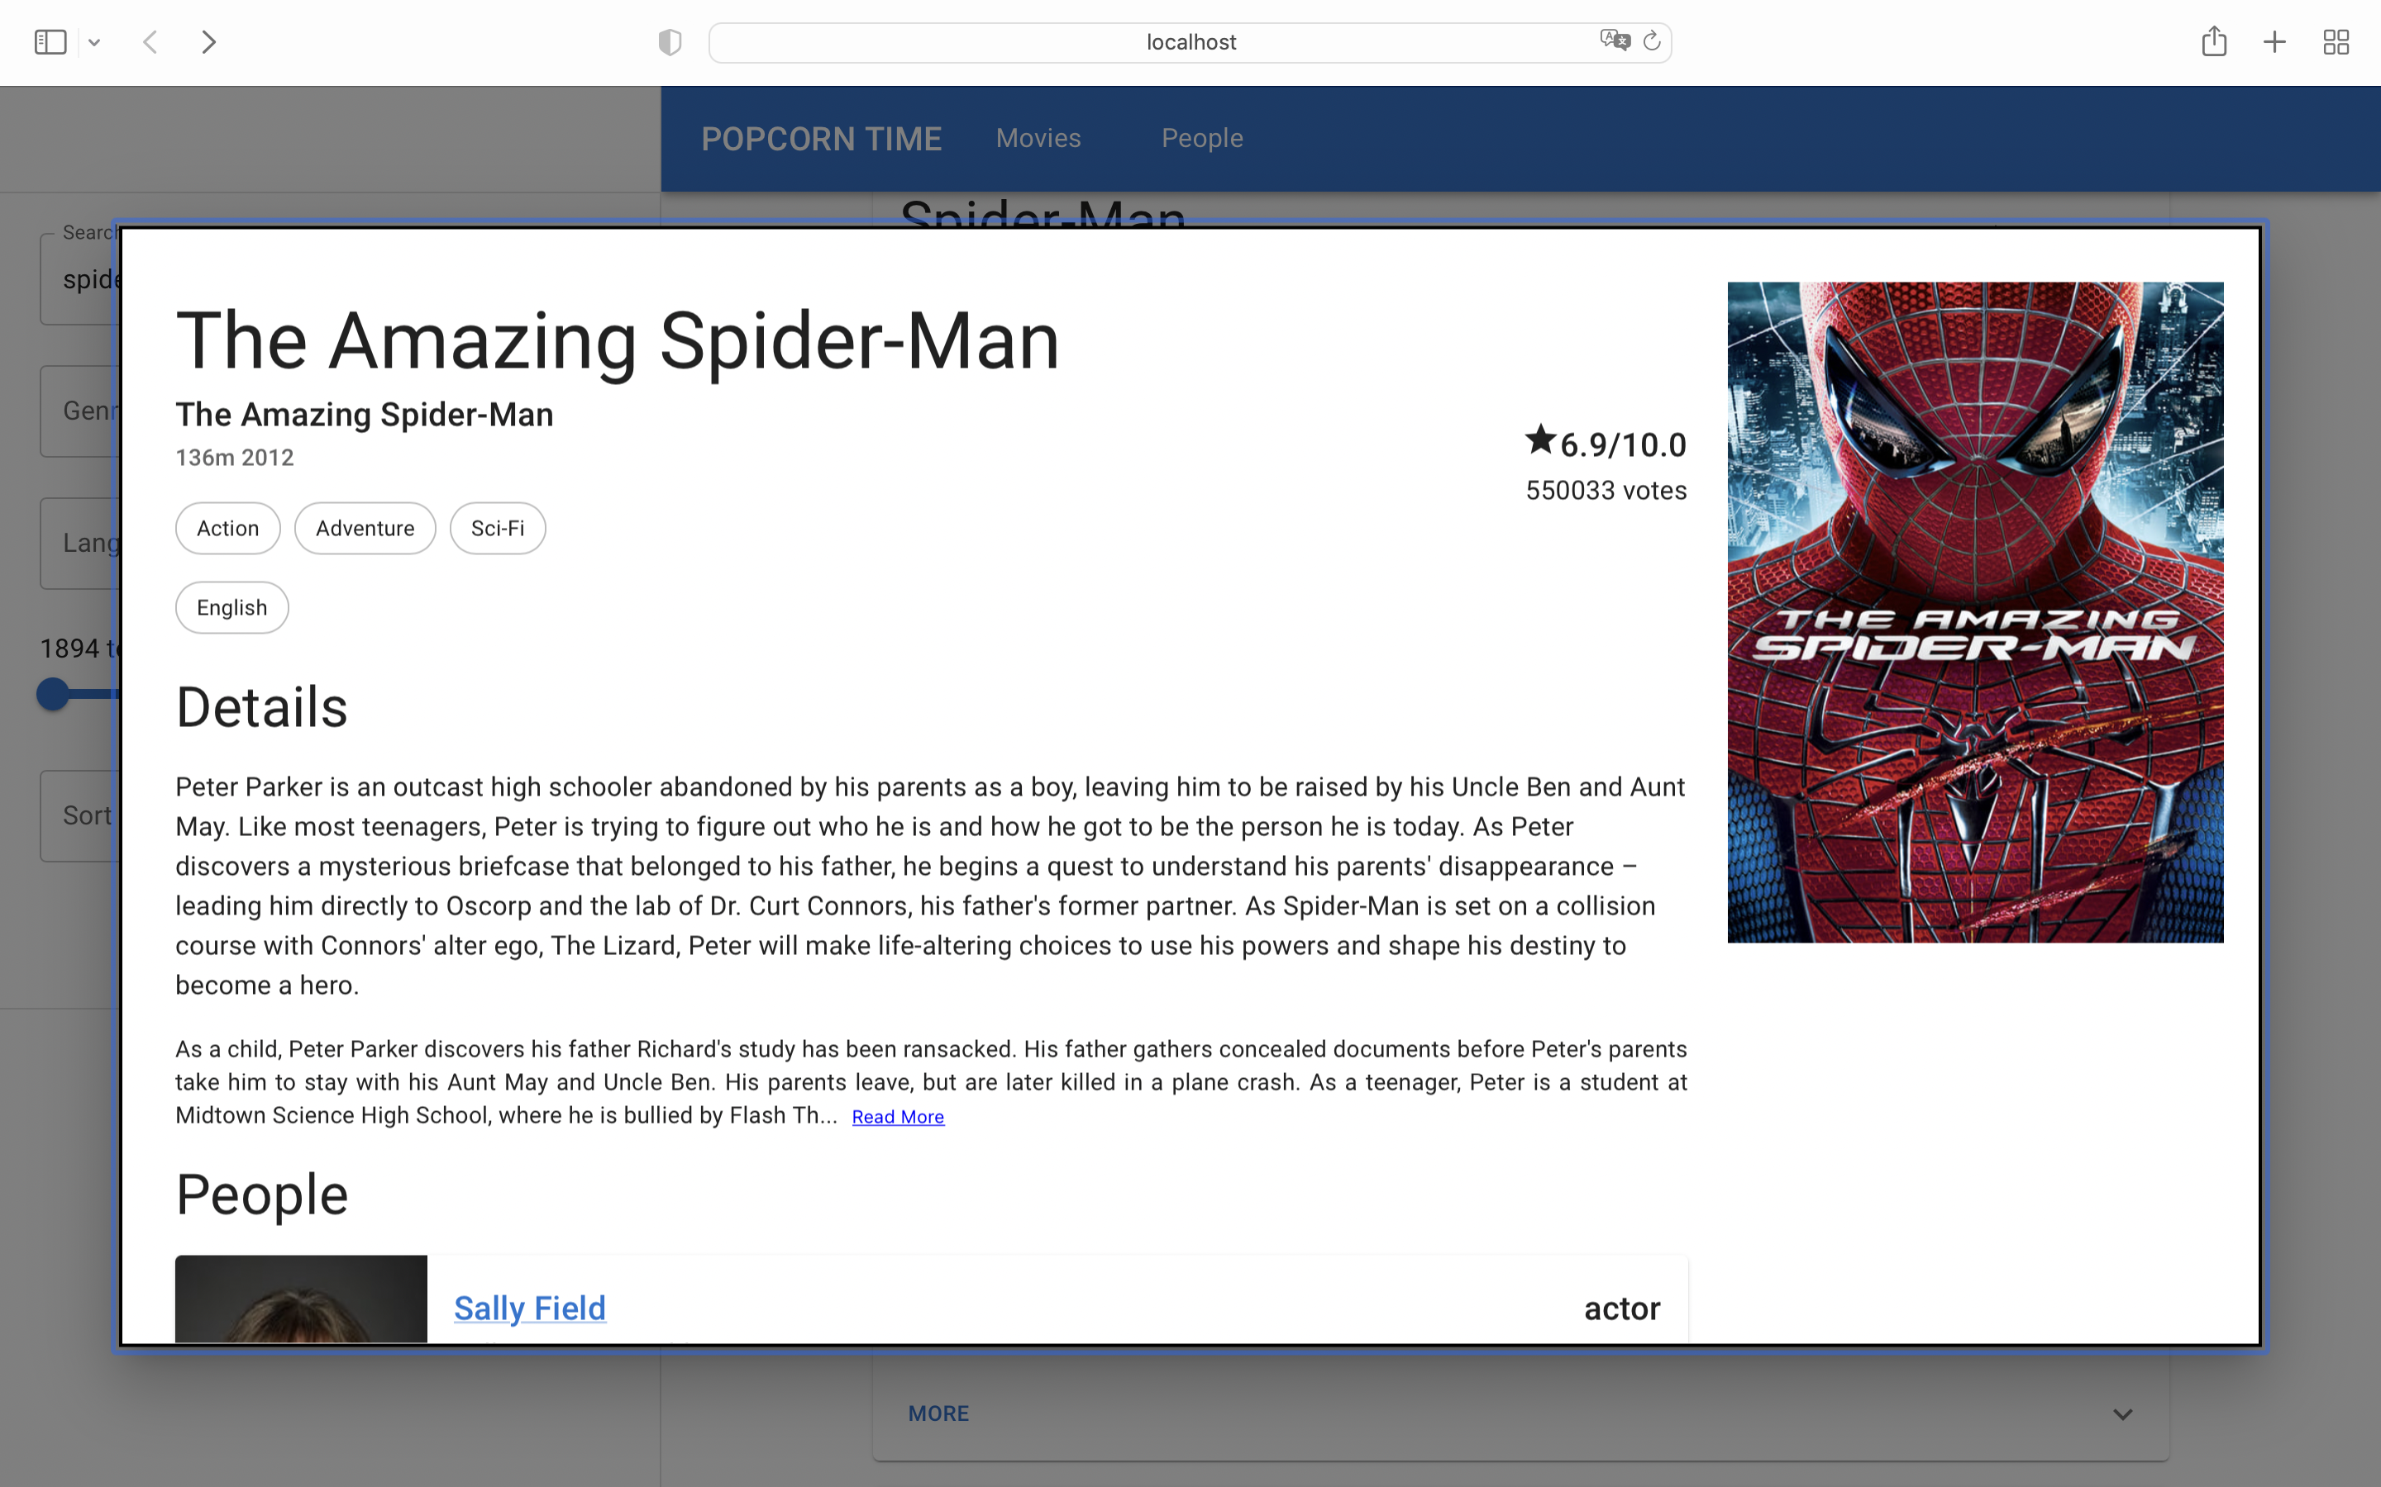

Slide 7
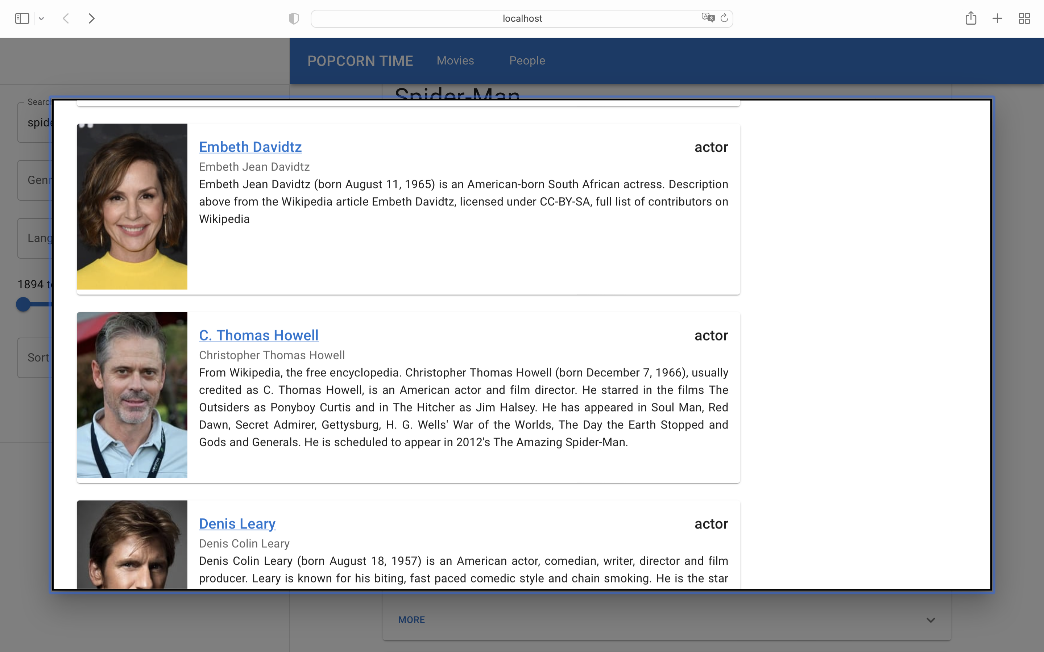

Slide 8
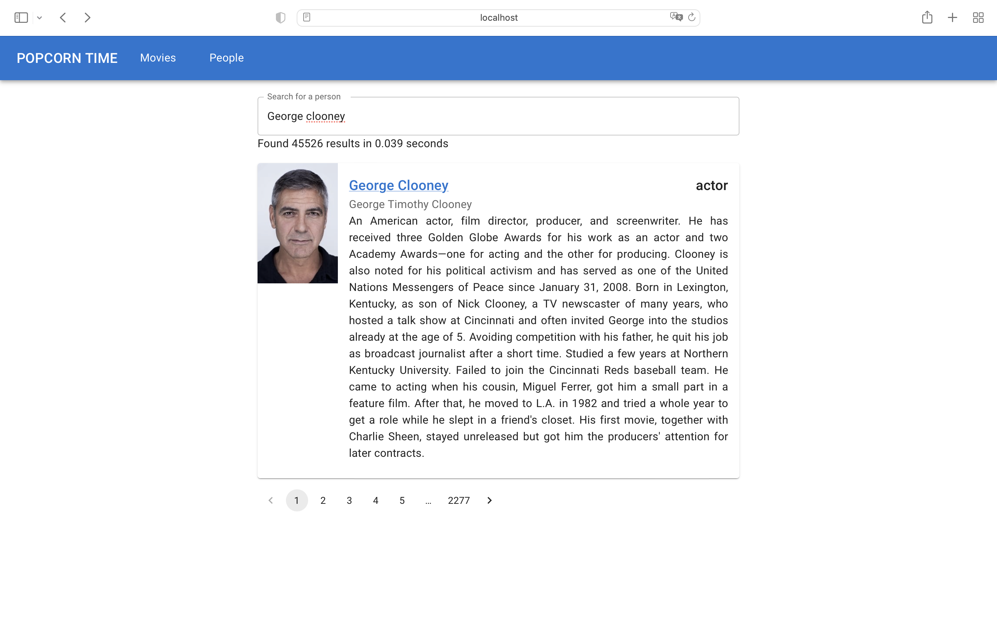

Slide 9
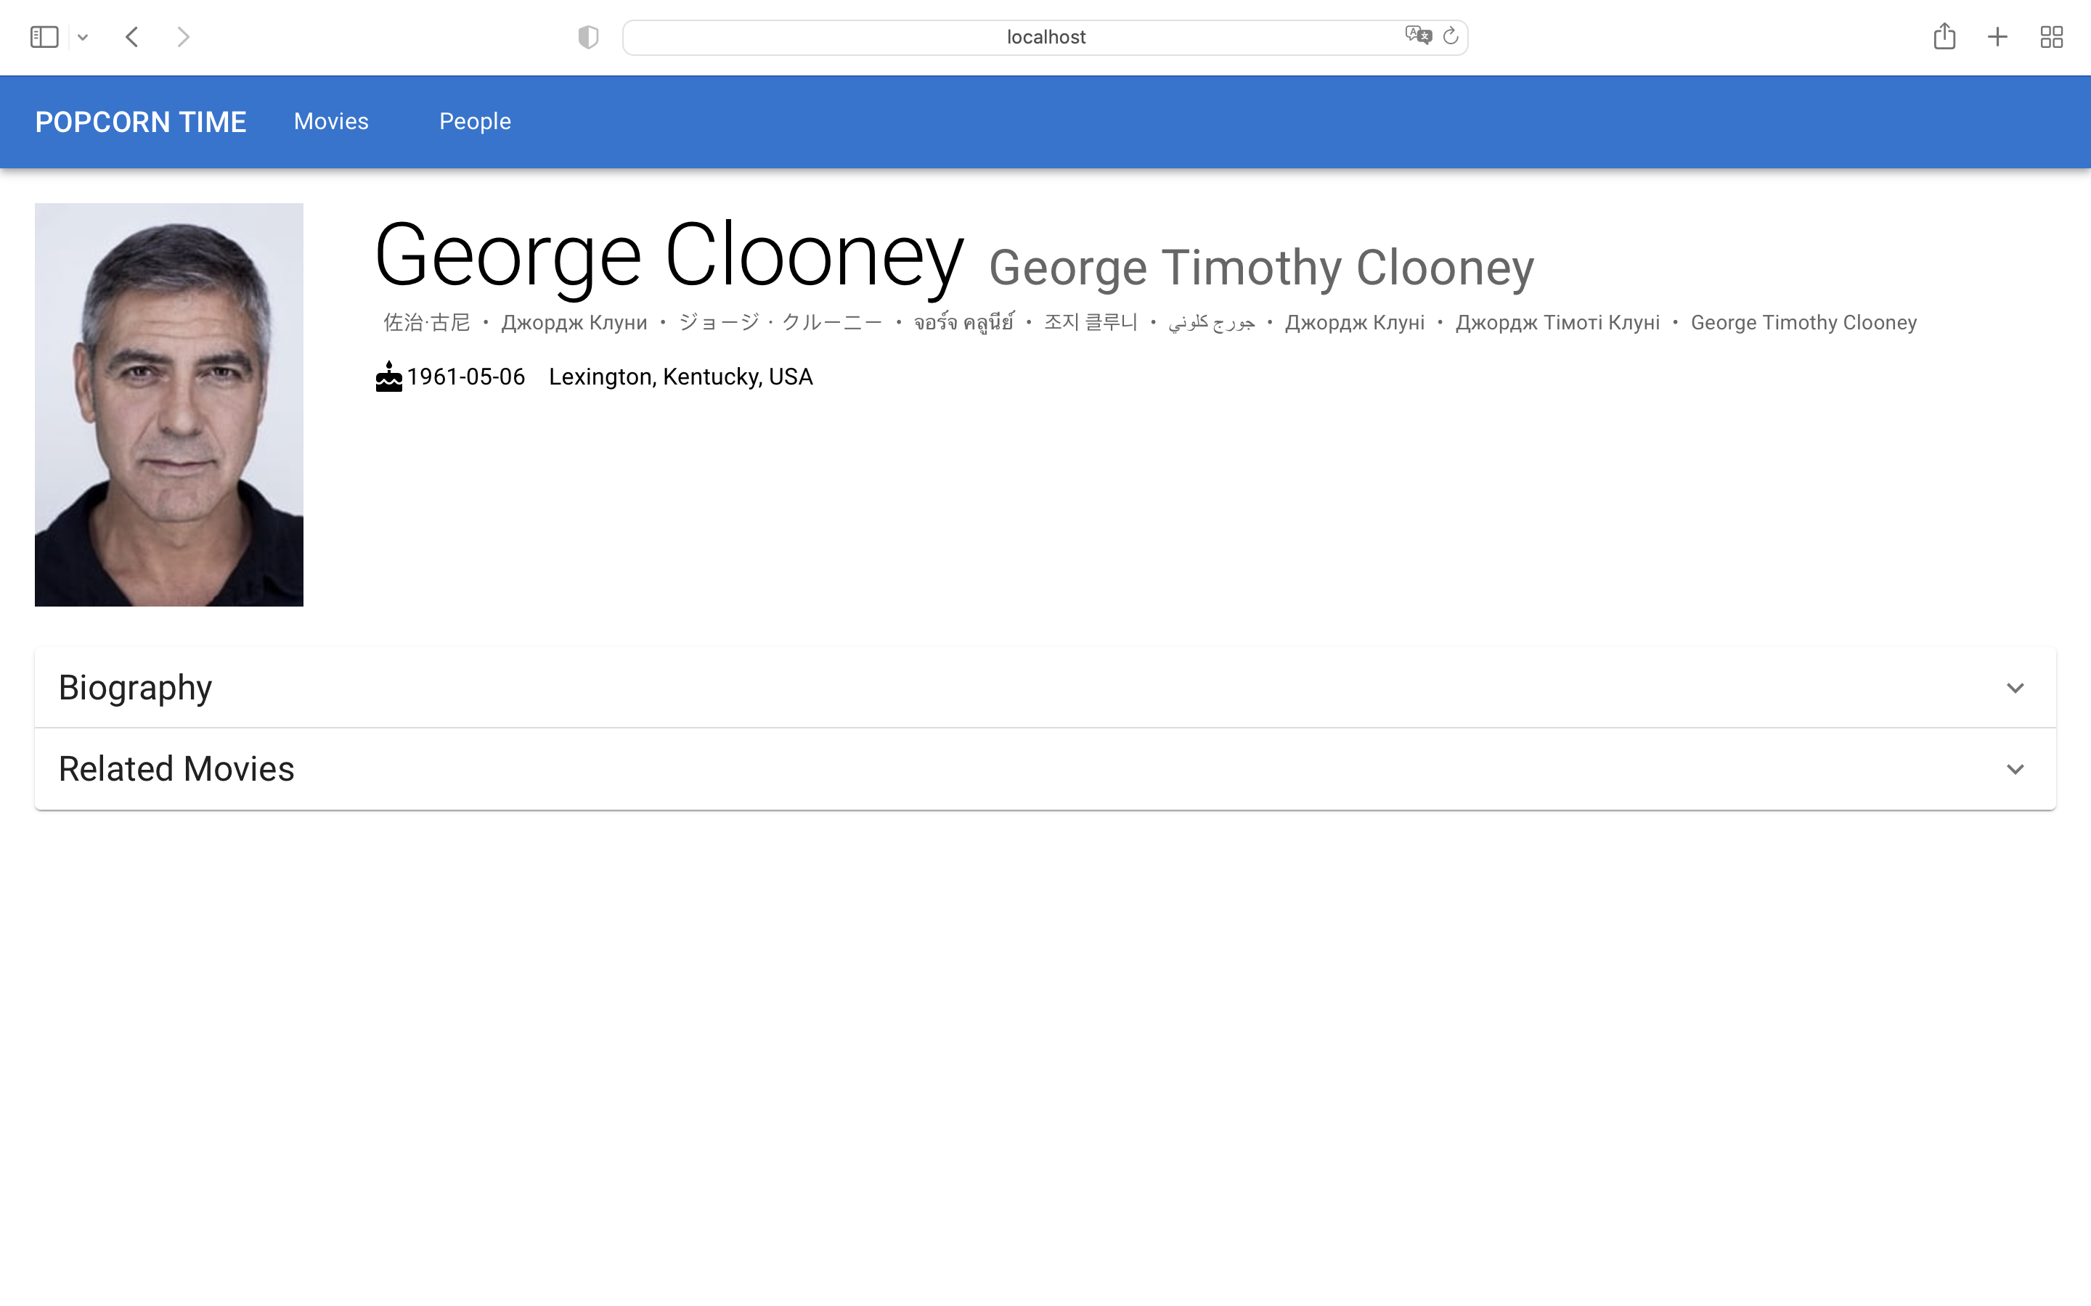

Slide 10
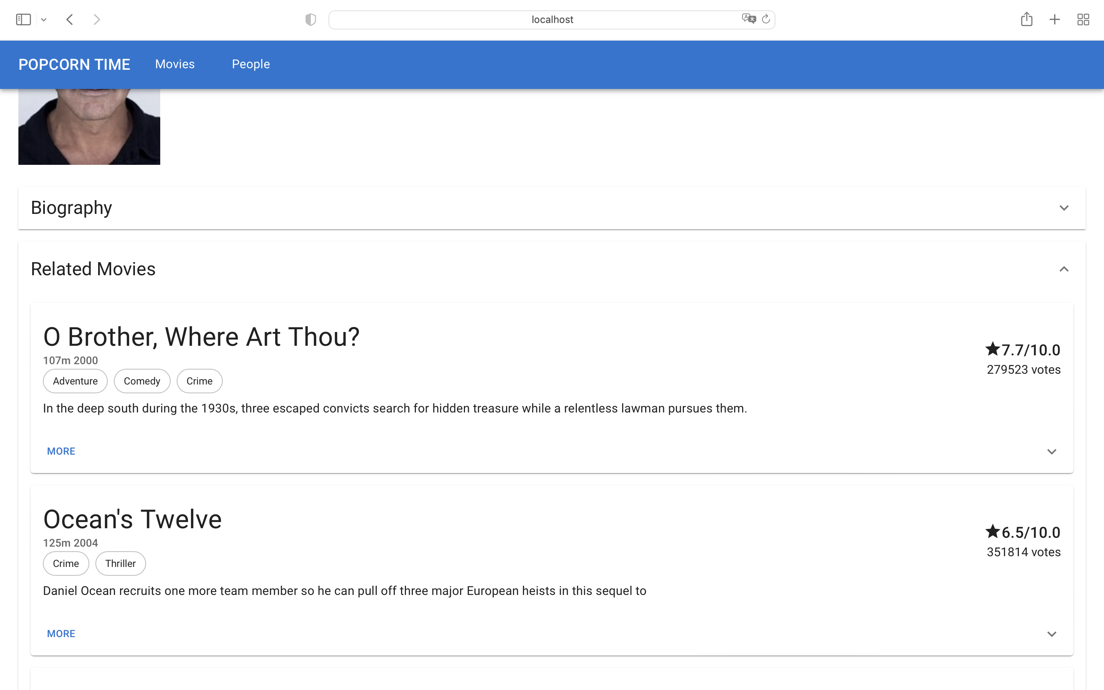

Slide 11
Conclusion

